Slide 1
CS302 MVP Presentation
Sherwin & Az
11 Nov 2023

Slide 2
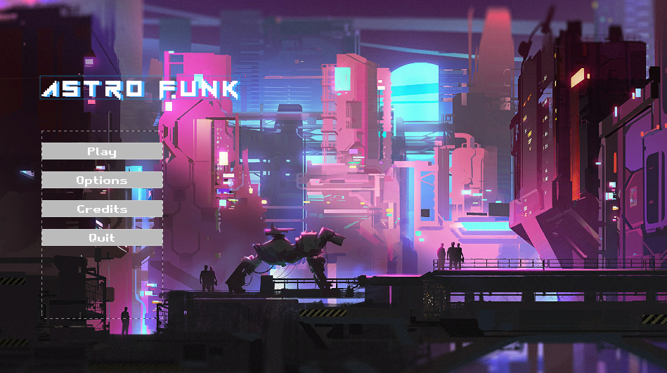
Astro Funk
FPS RPG - first person combat focusing on ranged weapons, with hyper mobile movement, and dialogue driven player choices
Movement - parkour is integral to the movement, with levels being designed with verticality and movement in mind

Slide 3
Previous Development

Slide 4
Core Functionality
First Person Perspective - using true FPS where the main character has a body.
Basic Level Design - a basic test level was created.
Weapon Mechanics - alternate firing modes, as well as Aim Down Sights (ADS) functionality, reload weapon swap
Movement mechanics - wall running, crouching, sprinting etc.

Slide 5
MVP Scope
Core FPS Mechanics
Level design
Narrative design
Creating harmony between level, FPS and narrative design
Focusing on core features, that is easily attainable by a 2 person team

Slide 6
What was achieved
Retooled FPS/Weapon mechanics - aiming fixed; sway from animations reduced, making weapon usage more accurate
NPC AI implementation - core functionality of NPC AI has been introduced, with easy paths forward for developing a complex system for narrative and gameplay purposes.
Level Design - the first level features a more vertical layout, that better fits the movement mechanics, thus providing harmony of between level and game design

Slide 7
MVP Development

Slide 8
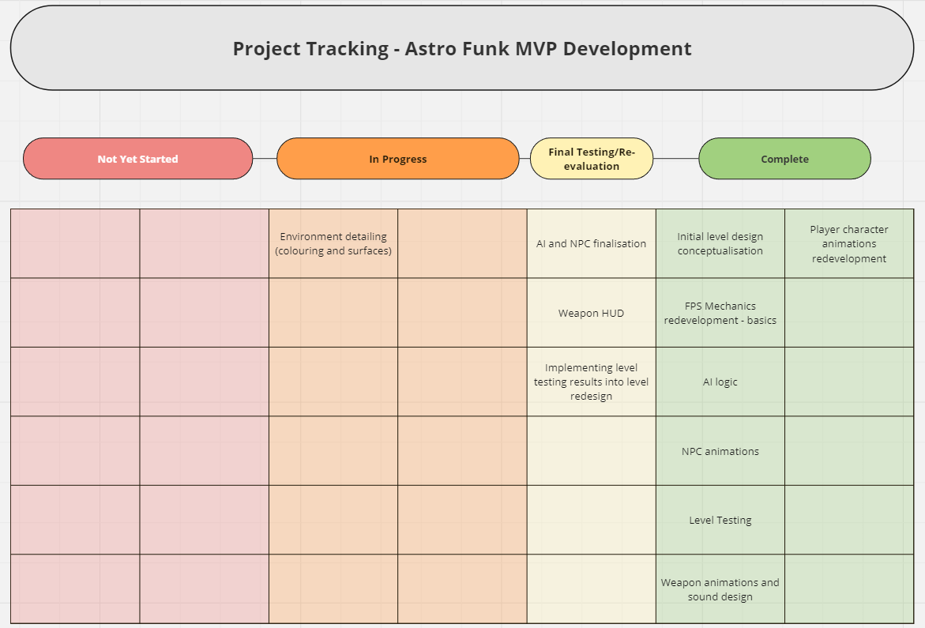
Project Management
We created a chart, using Miro, at the beginning of development to be able to track what was not yet complete, what was yet to begin development and what was complete or in its final stage before implementation

Slide 9
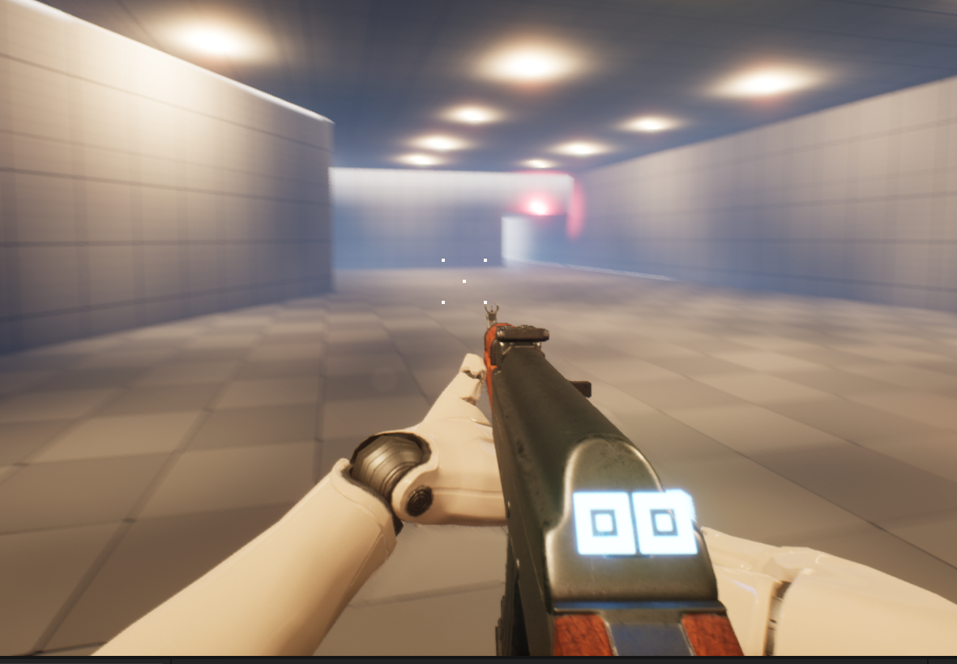
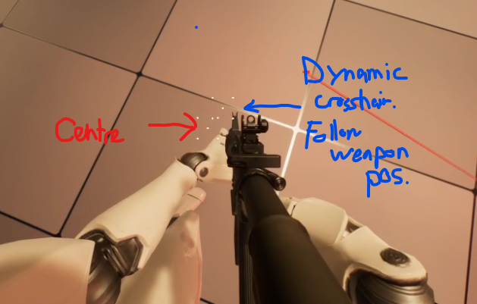
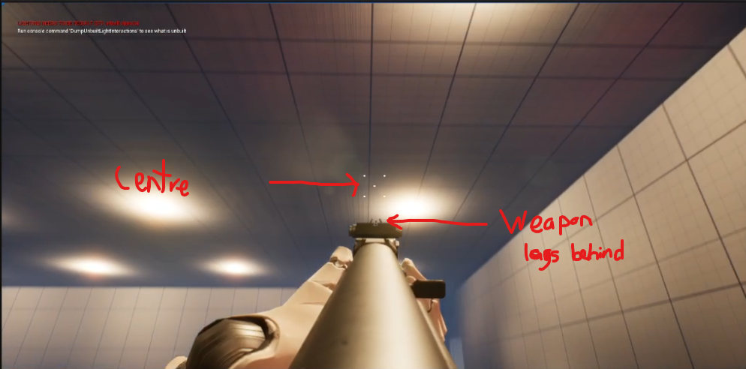
FPS Mechanics
A lot of focus was placed on the weapon and its animations, as well as developing a usable HUD that would provide necessary information in a diegetic way (contained within the game world)
The crosshair proved to be a particularly difficult part of development, as the gun and crosshair moved at different speeds when moving the camera on the Y axis

Slide 10
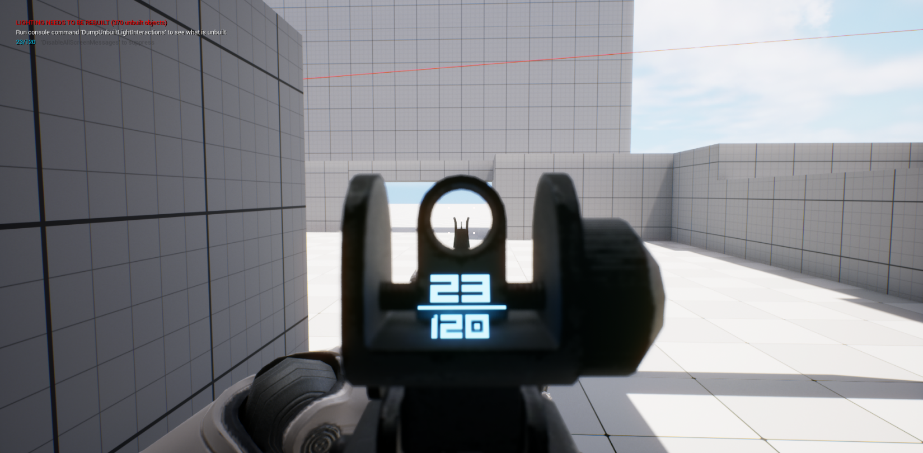
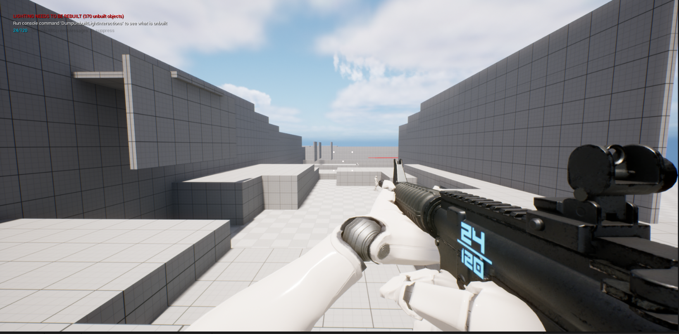
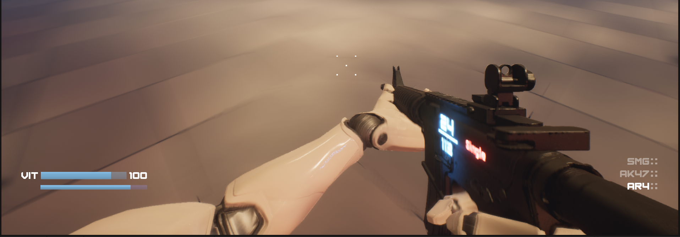
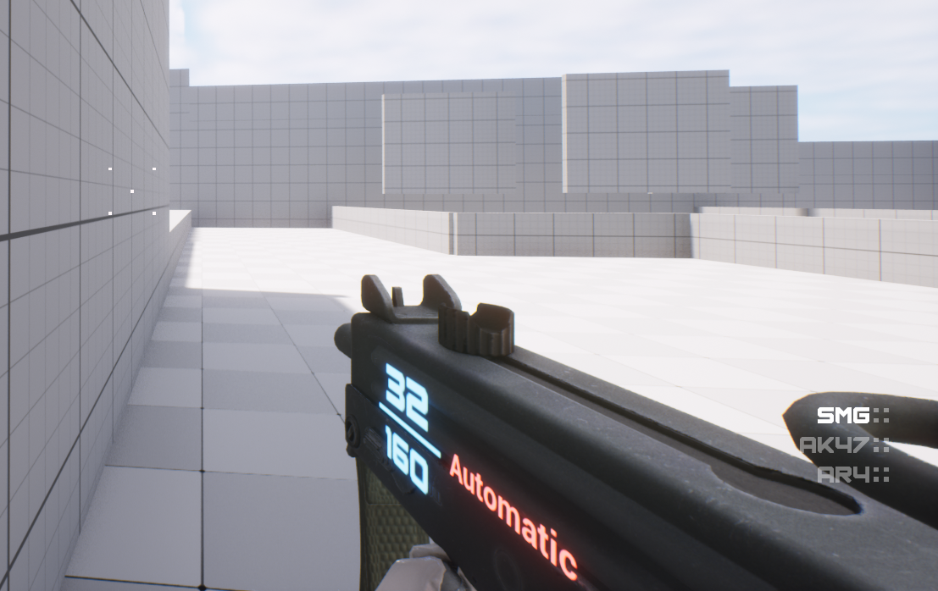
FPS Mechanics
HUD Display
A minimalistic HUD is used to immerse player.
Uses 3D widget attached to gun to display weapon ammo and firing mode.
Weapon Inventory displays currently equipped.

Slide 11
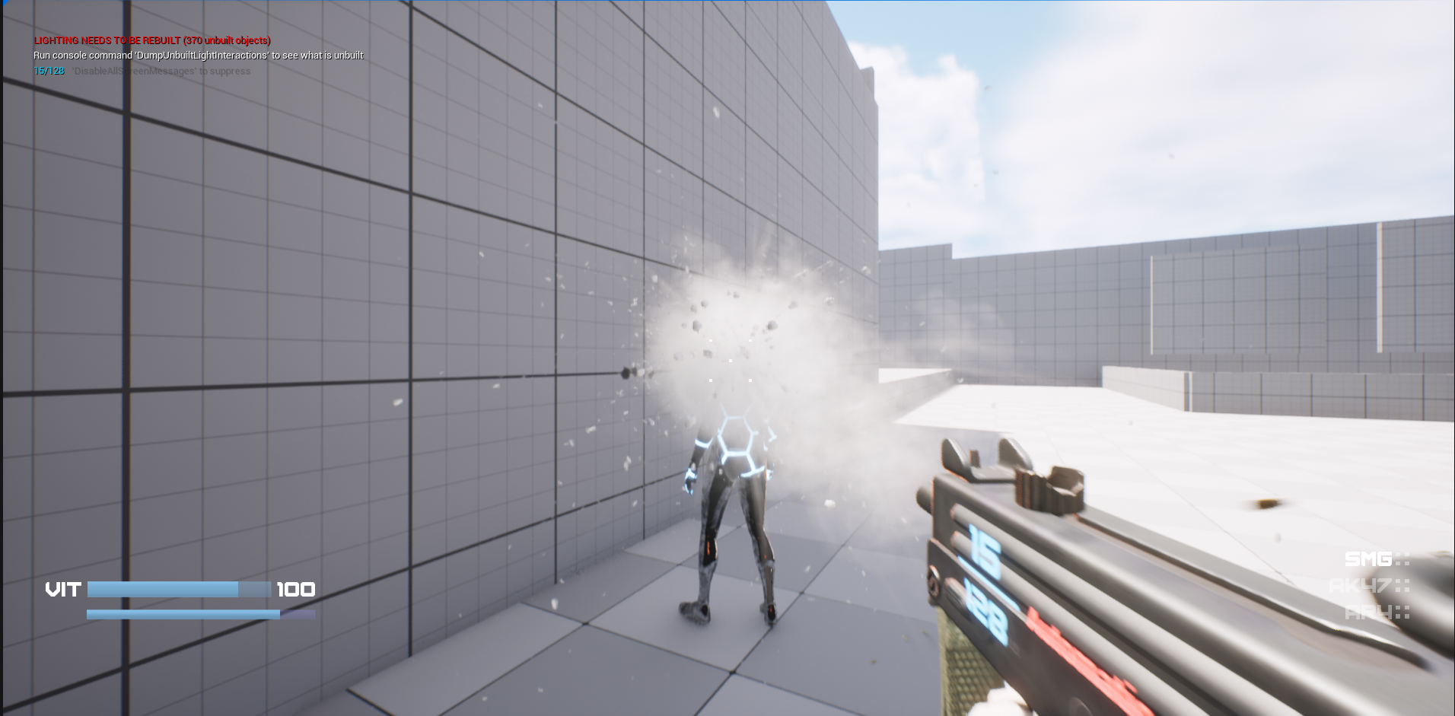
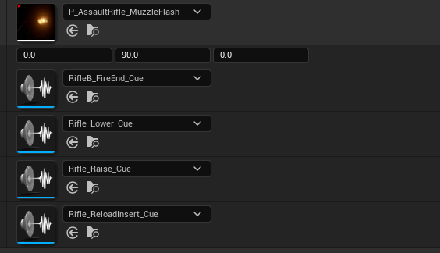
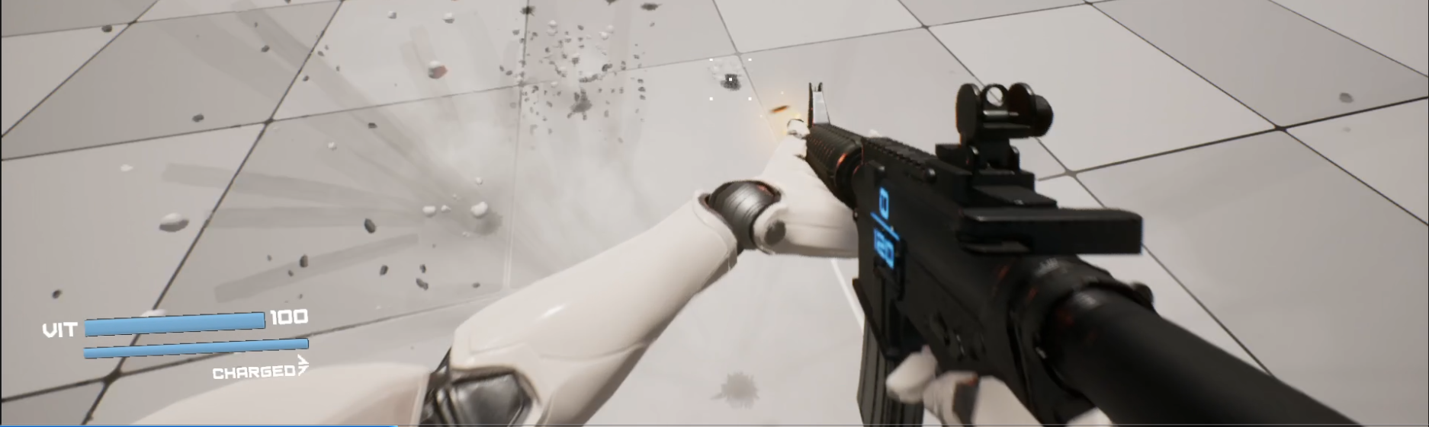
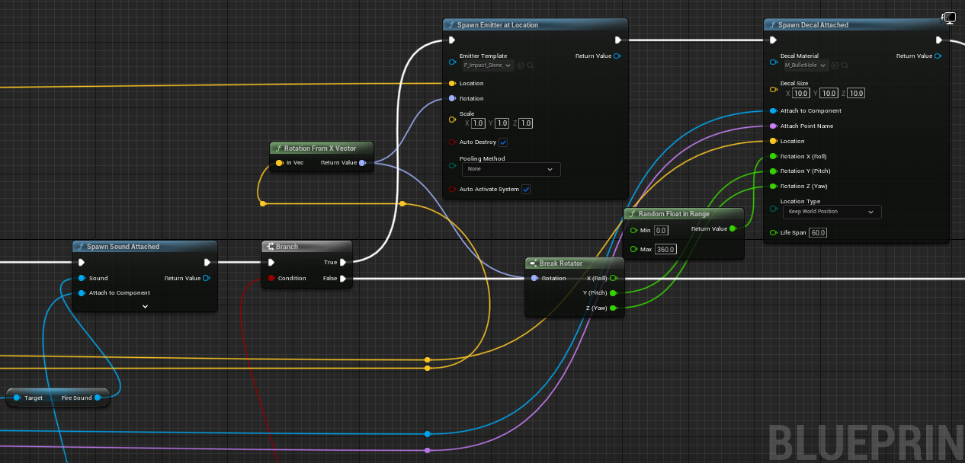
FPS Mechanics
Weapon Effects
Weapon effects added equip animation, reload sound, muzzle flash and impact detail.
Weapon sway reduced.
Shell Ejection fixed and properly spawns from eject socket.

Slide 12
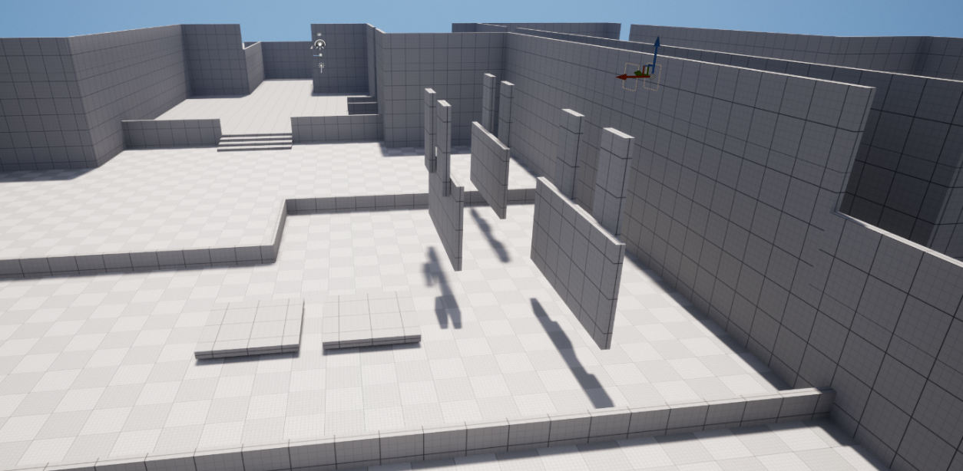
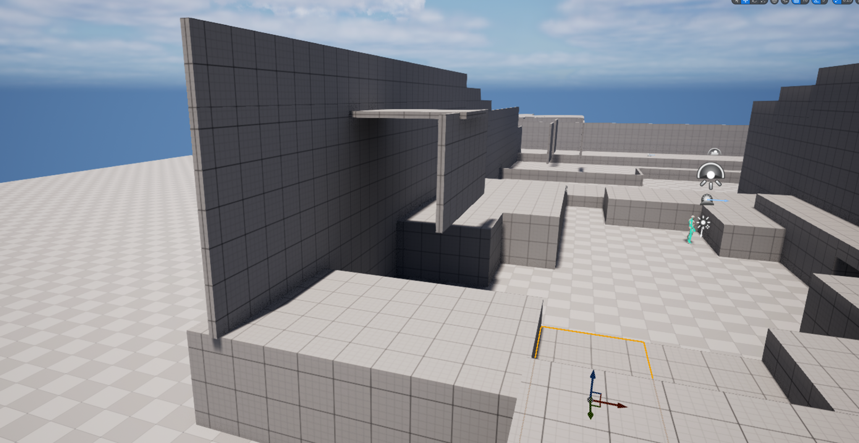
Level Design
A key focus of level design after testing was to create a level that allowed the player to use the games mechanics more effectively
As can be seen below, this involved creating vertical space within the level, as wall running and jumping are integral movement mechanics

Slide 13
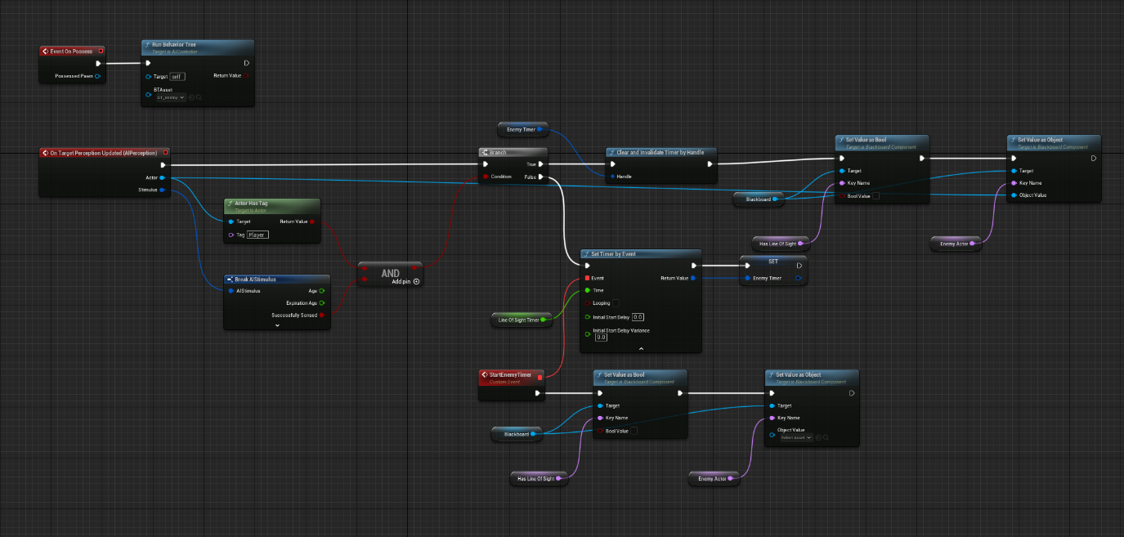
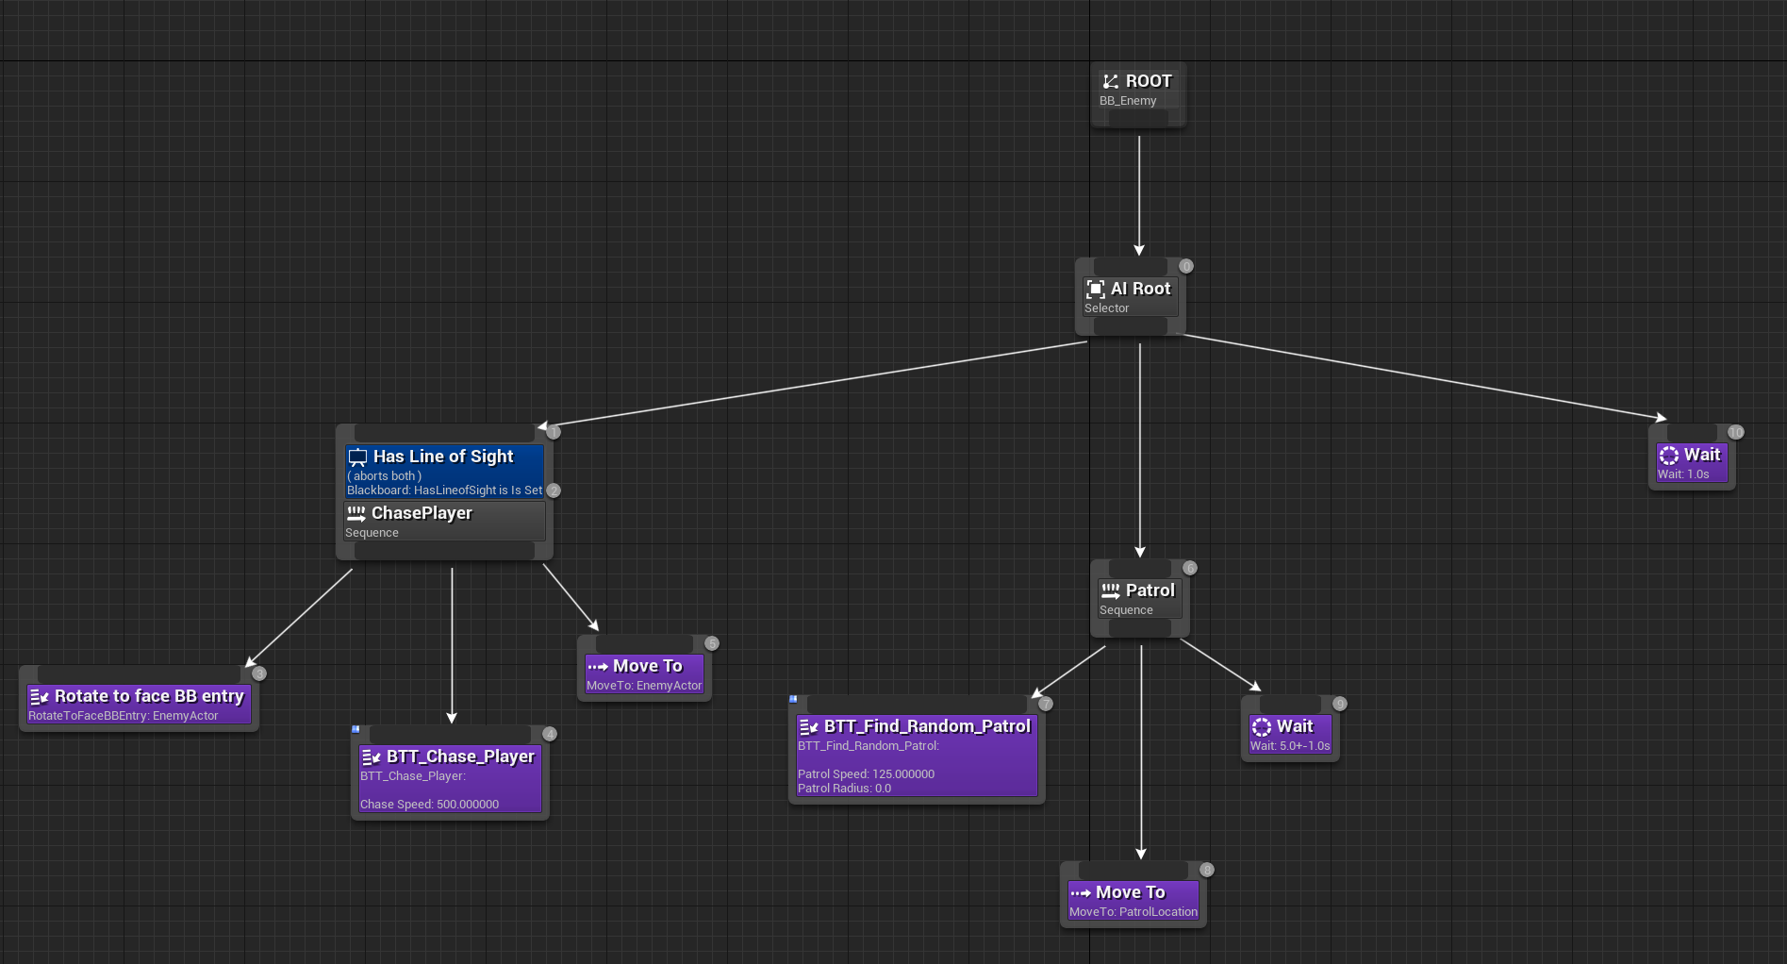
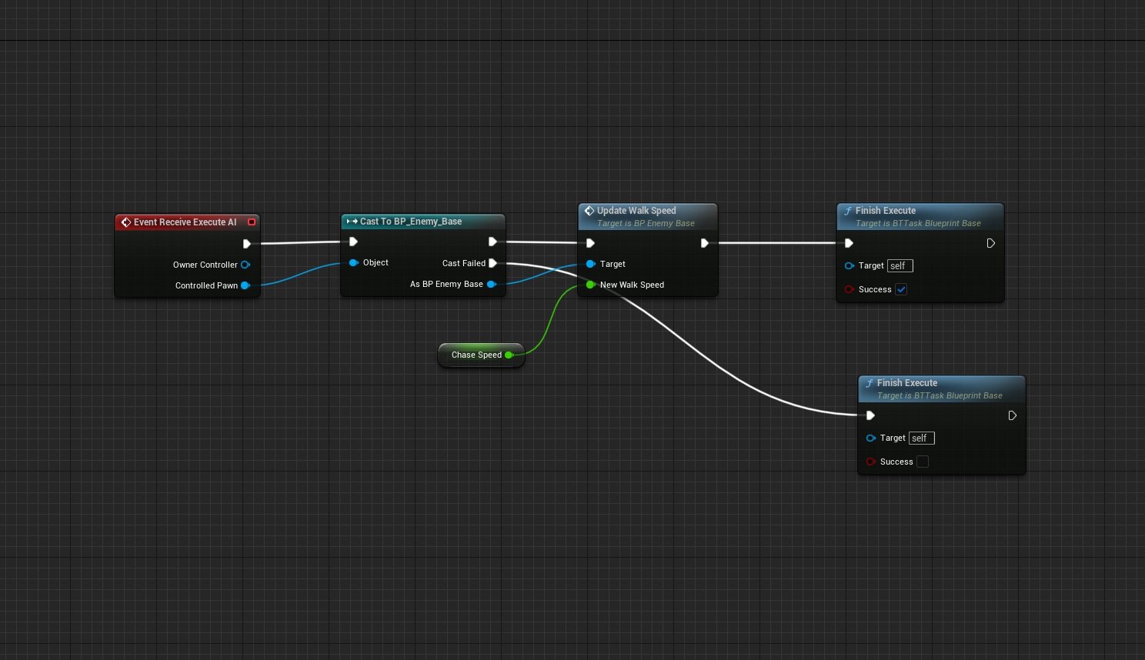
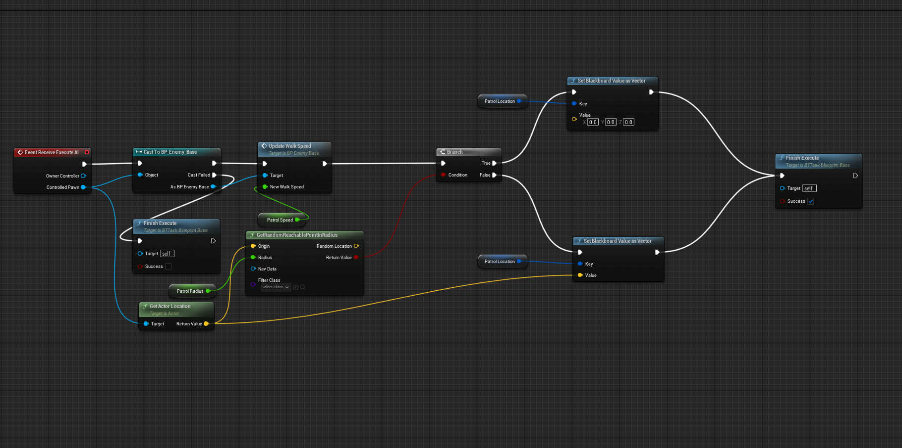
AI and NPC Development
NPC Logic
NPC design was the final core focus of development. Having (currently basic) AI that was functional and easy to add to was a key consideration
This was achieved by using blackboards, blueprints and behaviour trees. Blackboards specifically allow for easily storing AI controller variables, as well as providing and easy way to get/set said variables
Behaviour trees are essential in AI functionality execution

Slide 14
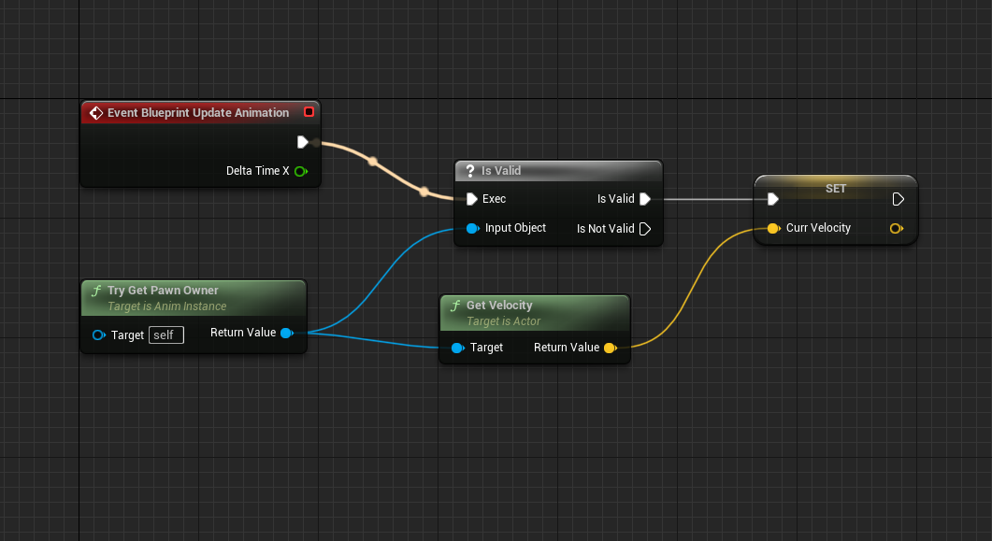
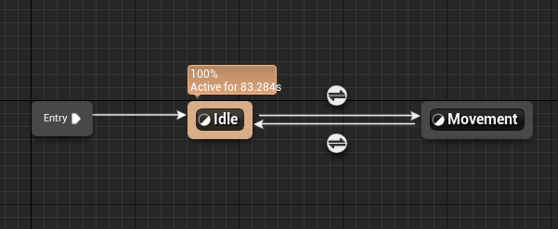
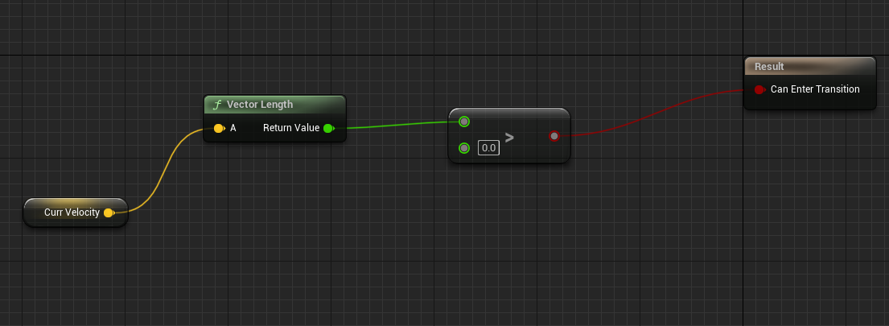
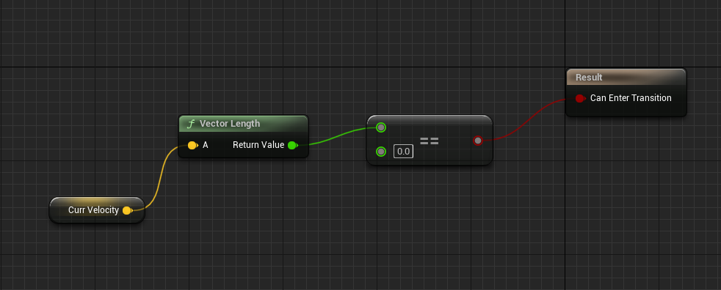
AI and NPC Development
Animation
Animation is the other half of NPC development. Having a working AI that isn’t capable of moving is pointless
Animation in Unreal is easy, using blueprints, event graphs and state machines to check what the AI has sensed, whether that sense requires an animation, and then changing the animation state of the NPC skeleton
Blend spaces are essential in creating smooth changes between animations, such as going from idle to running

Slide 15
Challenges

Slide 16
Working Practices
Stress/Burnout Management - Burnout and stress played key roles in the pace of development on this project. Better time management, beyond just project timelines and development targets would likely be beneficial.
Time – Time was also a limiting factor in development. 16 weeks, with 2 people was likely not enough to hit some of the development targets we set at the beginning of the semester

Slide 17
Scale
One issue we ran into was scale. Specifically with things such as AI development and narrative design. Narrative design was not focused on in this MVP, and this can be attributed to the number of resources required. A team of writers and programmers will often spend months, even years, focusing on how narrative and its impacts on gameplay, which is simply beyond the scope of a 16-week project with two people.

Slide 18
Thank you for attending our presentation
We have a demonstration video to show

